Slide 1

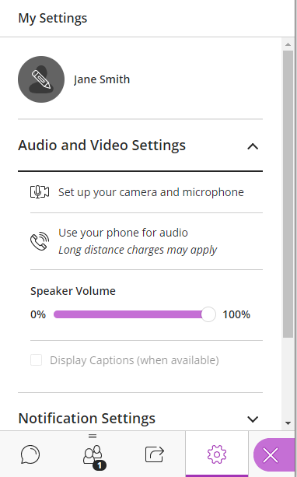
Title of Session
Name of presenter
Please run through the following before we begin:
Step 1: Click on the purple tab
(bottom right)
Step 2: Set up camera and microphone settings
Open Collaborate Panel Icon at (bottom right) > My Settings icon (looks like a cog).
Click on Audio and Video Settings, then Set Up your Camera and Microphone.
Preview your audio and camera.
Step 3: Set up speaker and microphone volume
My Settings icon.
Click on Audio and Video Settings and adjust your speaker and microphone volume.
My Settings Icon

Slide 2
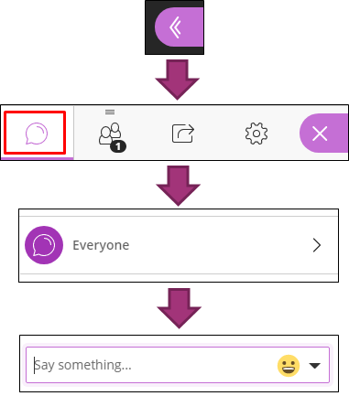
Audio Check
I’m now talking - Can you hear me ok?
Please indicate yes or no using the text chat tool.
The Chat is accessed via the purple tab in the bottom right corner.

Slide 3
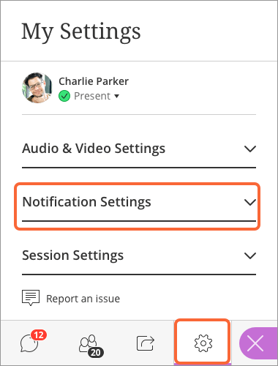
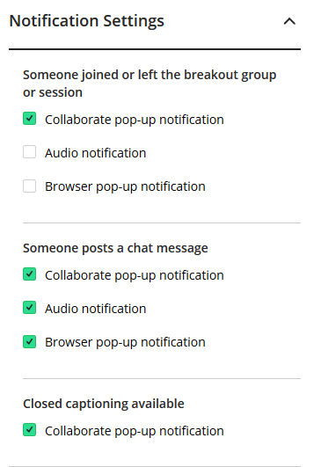


Your Notification Settings
To change your notification settings go to the Collaborate panel (purple button at bottom right)
Select My Settings
Select Notifications Settings.
Switch off all audio notifications.

Slide 4

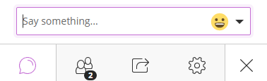

During the Q&A Session
Use the hand raise icon to queue up your question.
When called upon to ask your question type a question in the Chat.
Or click on the Audio icon then speak your question.

Slide 5
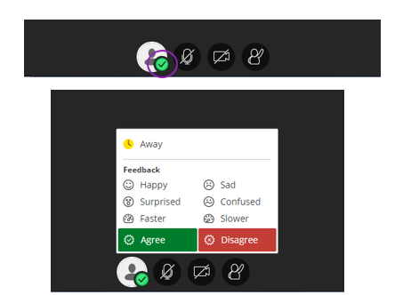

Emoticons and Feedback
Click on the green tick
Then choose your emoji Happy / Agree. This will then appear next to your name for 10 seconds.
View reactions across the cohort in the Attendee list.

Slide 6
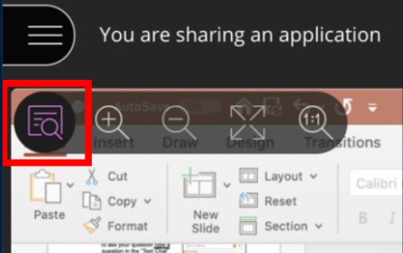
Viewing the Screen
You can change the view of your screen by using the tools in the top left corner or double click on the collaborate window

Slide 7
Recording Statement
[Statement for students if you are recording the sessions. Please see advice and example slides on this webpage to tailor to your situation.]
https://www.ed.ac.uk/information-services/learning-technology/communication/virtual-classroom-policy

Slide 8

Licence
Published by the University of Edinburgh under a Creative Commons Attribution-ShareAlike 4.0 International Licence.

